Slide 1
Data manipulation & methods

Slide 2
Objectives
Examine how computers represent data
Declare memory locations for data
Learn about the various data type
Declare and manipulate strings
Work with constants
Casting
Become familiar with the components of a method
Call class methods with and without parameters
Use predefined methods in the Console and Math classes

Slide 3
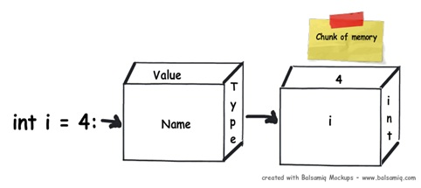
Data Variables
are memory/storage locations that hold data that can be changed during project execution.
Every variable has a type that determines what values can be stored in the variable
Used in programming for storing values, calculating and for reusability.

Slide 4
Constants
Memory locations that hold data that cannot be changed during project execution
declared using the keyword CONST and are given a name, a data type, and a value
Syntax
const type identifier = expression;

Slide 5
Declaring a Variable
When you declare a variable or a named constant, the compiler reserves an area of memory and assigns it a name, called an identifier.
Identifier names are specified according to the rules of Basic as well as some recommended naming conventions.
The syntax of declaring a variable is as follows: DataType VariableName;

Slide 6
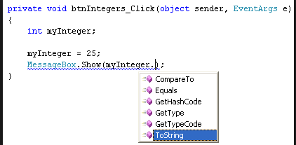
Declaring a Variable
Identifier
Name
Rules for creating an identifier
Combination of alphabetic characters (a-z and A-Z), numeric digits (0-9), and the underscore
First character in the name may not be numeric
No embedded spaces – concatenate (append) words together
Keywords cannot be used
Use the case of the character to your advantage
Be descriptive with meaningful names
Follow naming conventions / general naming conventions
int studentCount; // number of students in the class
int numberOfExams; // number of exams
int coursesEnrolled; // number of courses enrolled

Slide 7
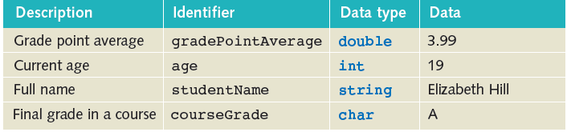
Data types
The type of data that a variable declaration specifies and defines what type of information will be stored in the allocated memory space.
Each time a variable is declared, C# requires that the variable data type is specified. This is because C# is a strongly typed language. Therefore prior to using a variable, the compiler must be aware of it….aware of what type of data is expected (msdn)

Slide 8
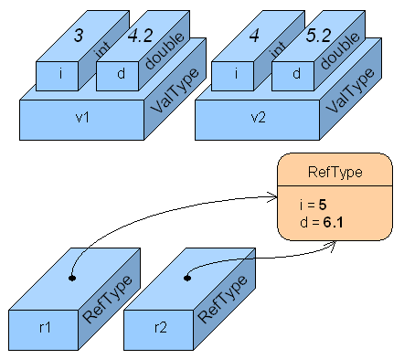
Data types
In the C# programming language, types are divided in three categories:
value types
reference types
pointer types

Slide 9
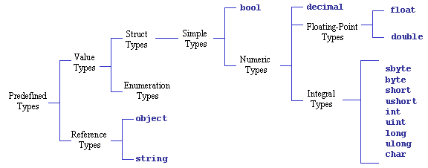
Data types
In the C# programming language, types are divided in three categories:
value types
reference types
pointer types

Slide 10
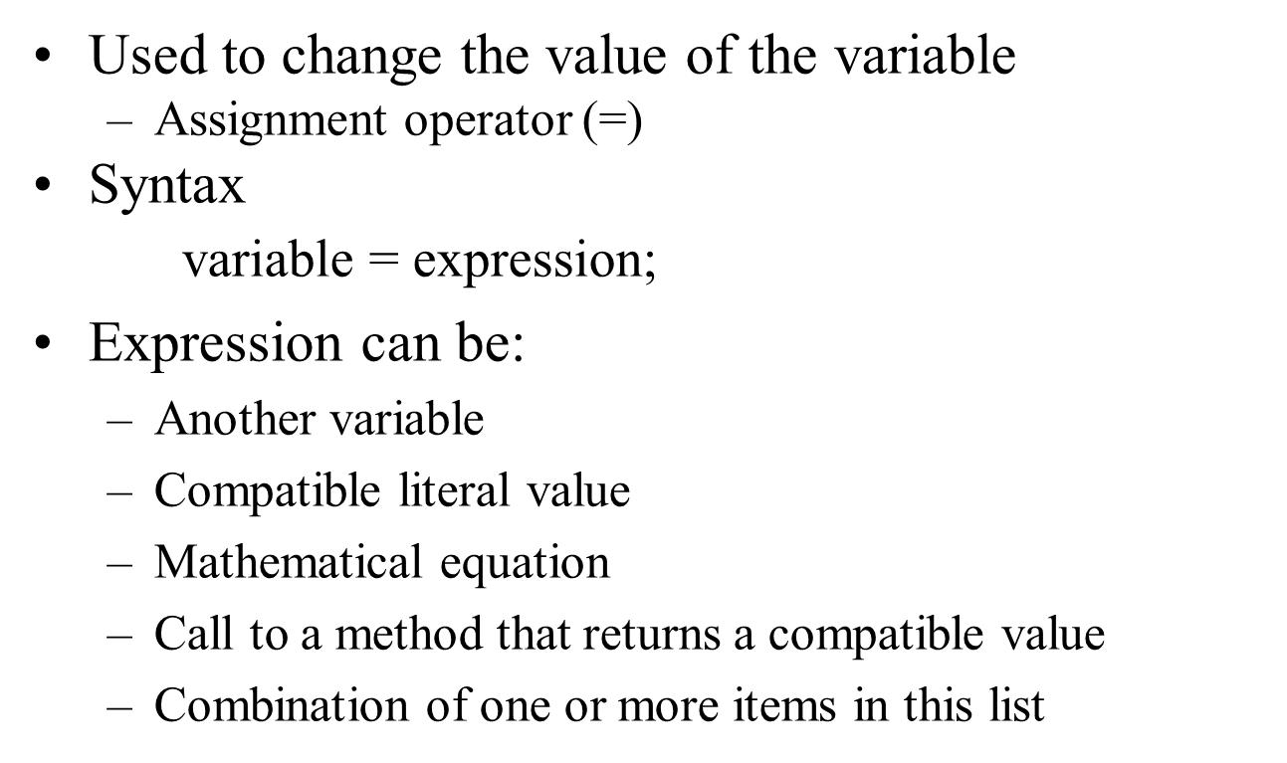
Assignment
To store a value in a variable you must use an =. Here is an example of how to store the value 5 inside an integer variable.
MyInt = 5;
You can store a value inside a variable when you declare it. This is called initializing the variable.
int MyInt = 5;

Slide 11
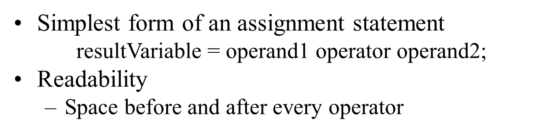
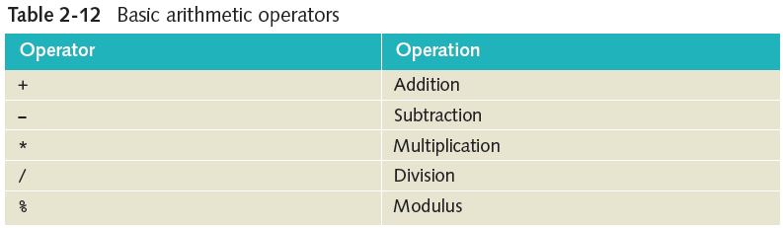
Arithmetic Operations

Slide 12
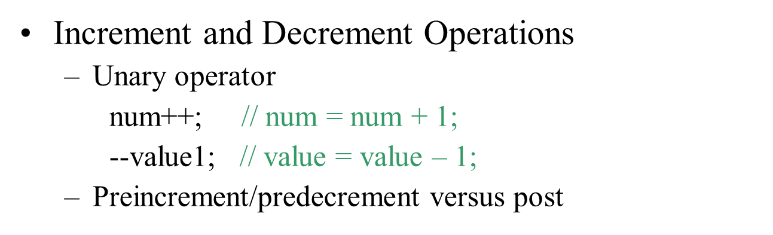
Basic Arithmetic Operations (continued)
int num = 100;
messagebox.show (num++); // Displays 100
messagebox.show(num); // Display 101
messagebox.show(++num); // Displays 102

Slide 13
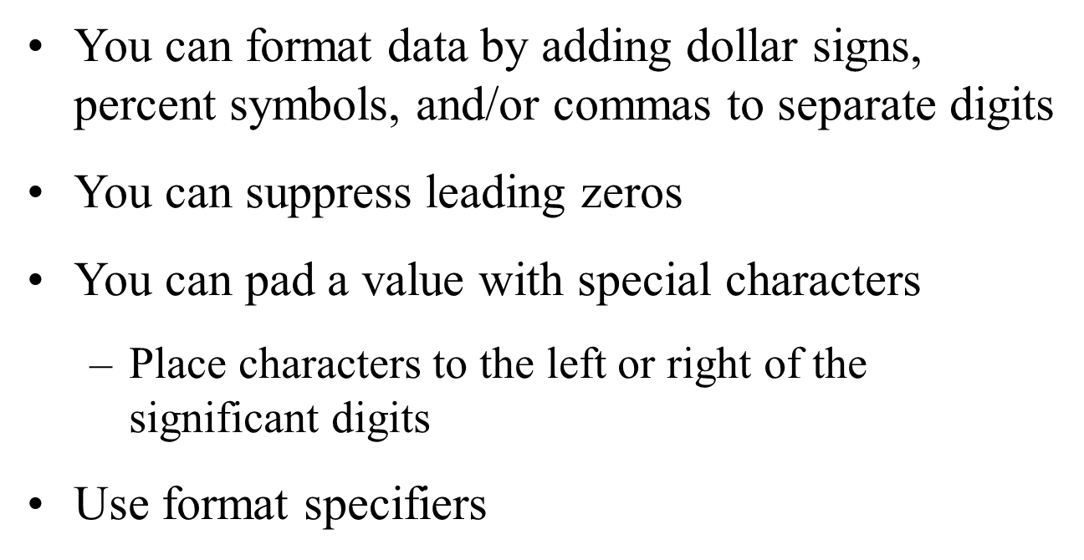
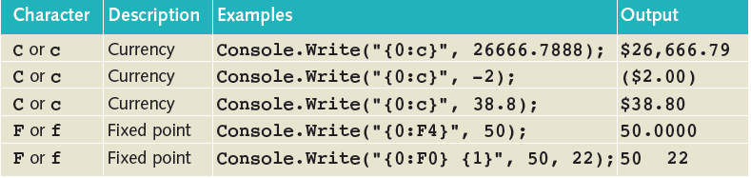
Formatting Output

Slide 14
Introducing Methods
The building block of object-oriented programming.
Combines related code together and makes program easier.
Methods defined inside classes
Group program statements
Based on functionality
Called one or more times
All programs consist of at least one method
Main( )
User-defined method

Slide 15
Methods structure
<Access Specifier> <Return Type> <Method Name>(Parameter List)
{
Method Body
}
Notes:
http://www.completecsharptutorial.com/basic/access-specifiers.php

Slide 16
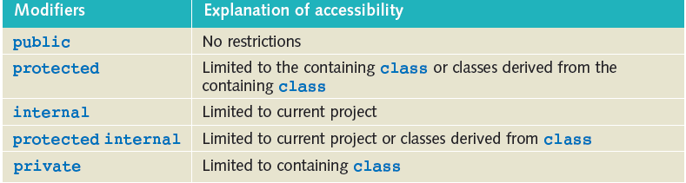
Defining Methods in C#
Following are the various elements of a method:
Access Specifier: This determines the visibility of a variable or a method from another class.
Notes:
http://www.completecsharptutorial.com/basic/access-specifiers.php

Slide 17
Defining Methods in C#
Return type:
Indicates what type of value is returned when the method is completed
Always listed immediately before method name
Void: No value being returned
Return statement
Required for all non-void methods
Compatible value
Notes:
A method may return a value. The return type is the data type of the value the method returns.
If the method is not returning any values, then the return type is void.

Slide 18
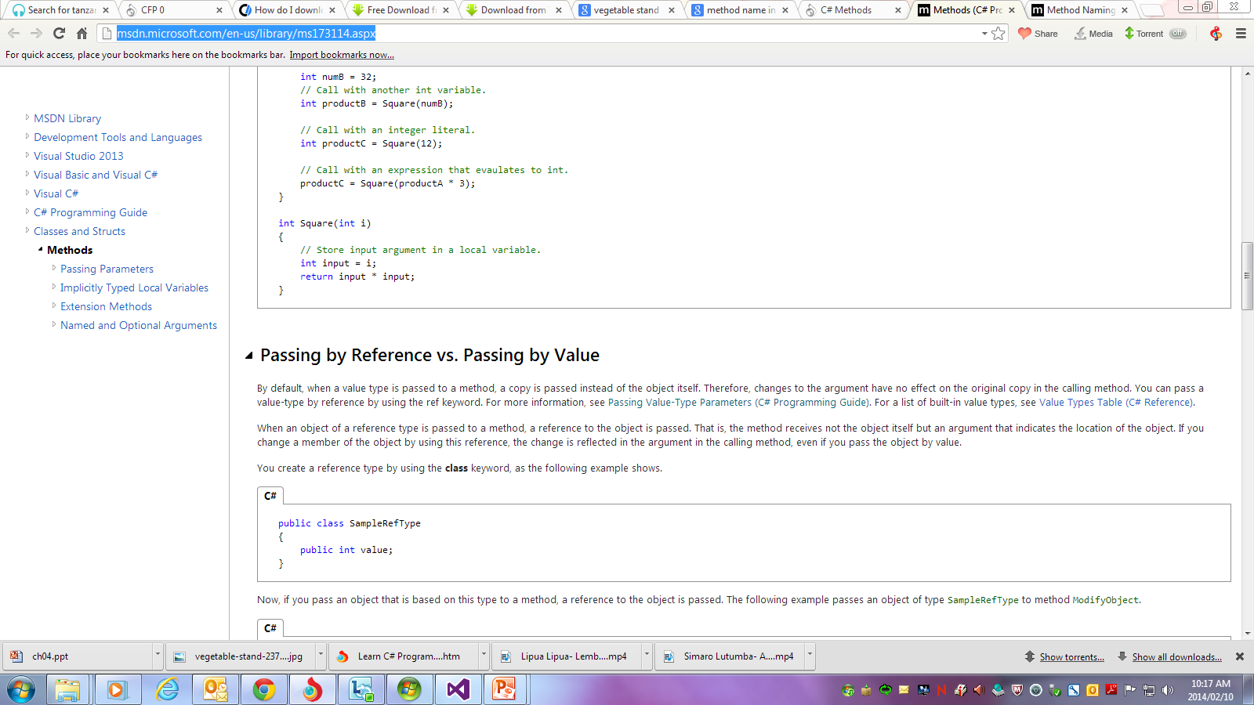
Defining Methods in C#
Method name:
Method name is a unique identifier and it is case sensitive.
It cannot be same as any other identifier declared in the class.
Guidelines on naming methods
Notes:
http://www.completecsharptutorial.com/basic/access-specifiers.php

Slide 19
Defining Methods in C#
Parameter list:
Parameter refers to items appearing in the heading
Enclosed between parentheses, the parameters are used to pass and receive data from a method.
The parameter list refers to the type, order, and number of the parameters of a method. Include data type and an identifier
Parameters are optional; that is, a method may contain no parameters.
Notes:
http://www.completecsharptutorial.com/basic/access-specifiers.php

Slide 20
Defining Methods in C#
Parameter list:
A Parameter is used to pass information to a function.
Based on type of parameters, a function responses and returns value.
A parameter can be passed to a function by two ways:
Passing parameter by value : A value type variable directly contains data in the memory
passing parameter by reference. A Reference type variable contains memory address of value.
See example, example2
Notes:
http://www.completecsharptutorial.com/basic/access-specifiers.php

Slide 21
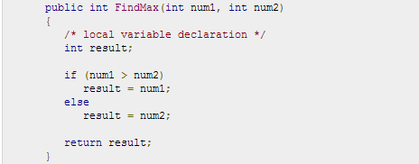
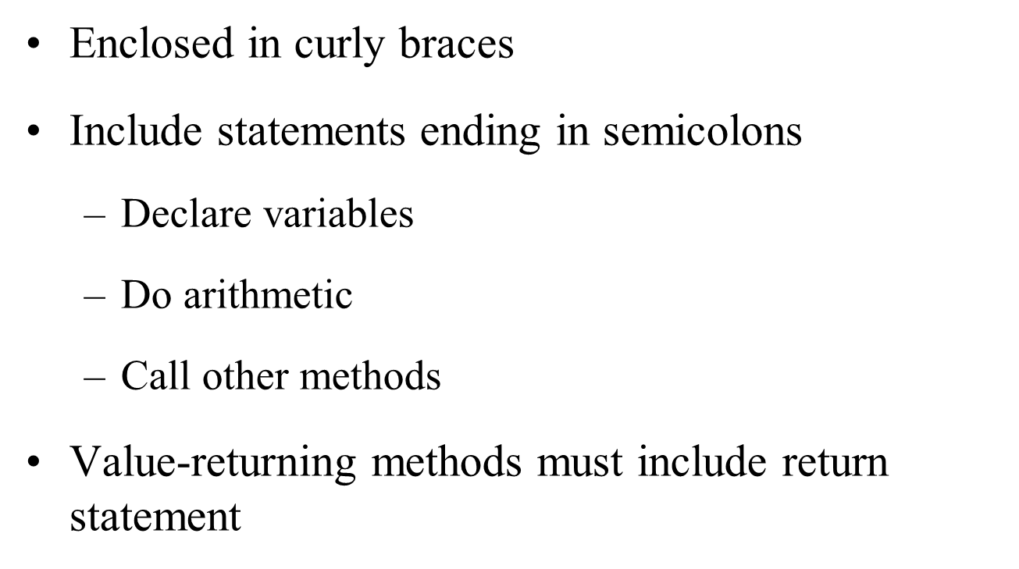
Defining Methods in C#
Method body:
This contains the set of instructions needed to complete the required activity.
See msdn
Notes:
http://www.completecsharptutorial.com/basic/access-specifiers.php

Slide 22
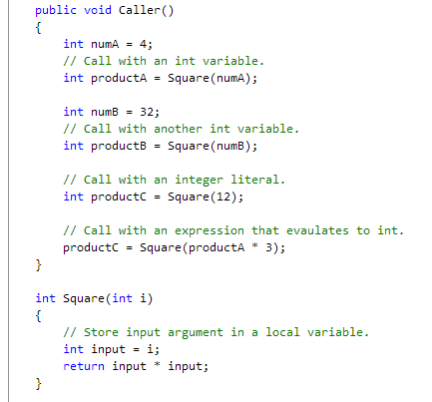
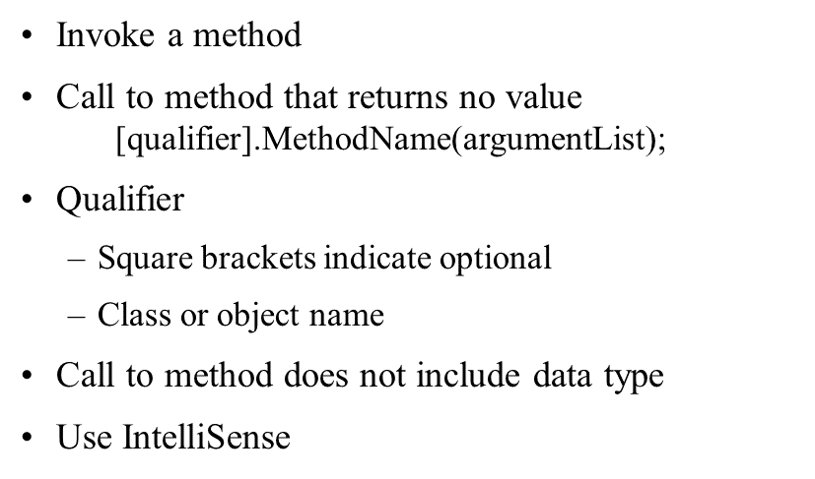
Calling a method

